Slide 1
Basic Biological Concepts
Emerging Treatments
Section 4 – Lecture 4

Slide 2
While we are currently facing a lot of major health and environmental concerns, we also have some of the most advanced and exciting scientific activity on our side.
Biomedical Sciences are those scientific disciplines whose primary focus is the biology of human health and disease
Medical microbiology, clinical virology, clinical epidemiology, genetic epidemiology, and biomedical engineering are medical sciences.
Basic sciences include anatomy and physiology, cell biology, biochemistry, microbiology, genetics and molecular biology, immunology, mathematics and statistics, bioinformatics, pharmacology, and human nutrition.
Biomedical Sciences are the major focus of bioscience research and funding in the 21st century.
Biotechnology is the use of living systems and organisms to develop or make products.
Depending on the tools and applications, it often overlaps with related scientific fields.

Slide 3
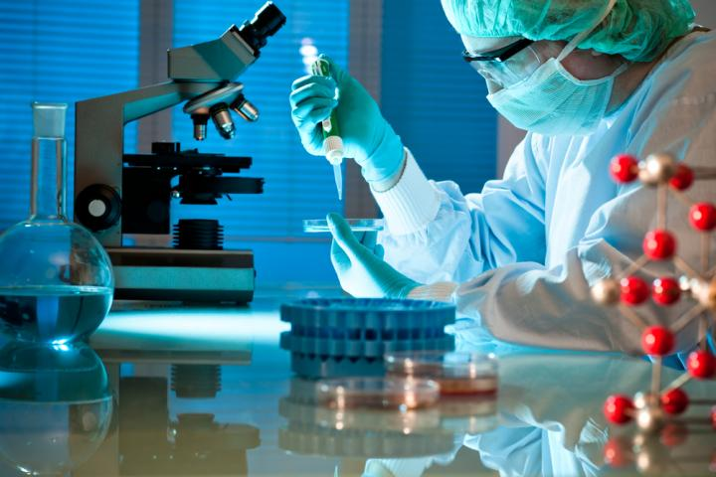
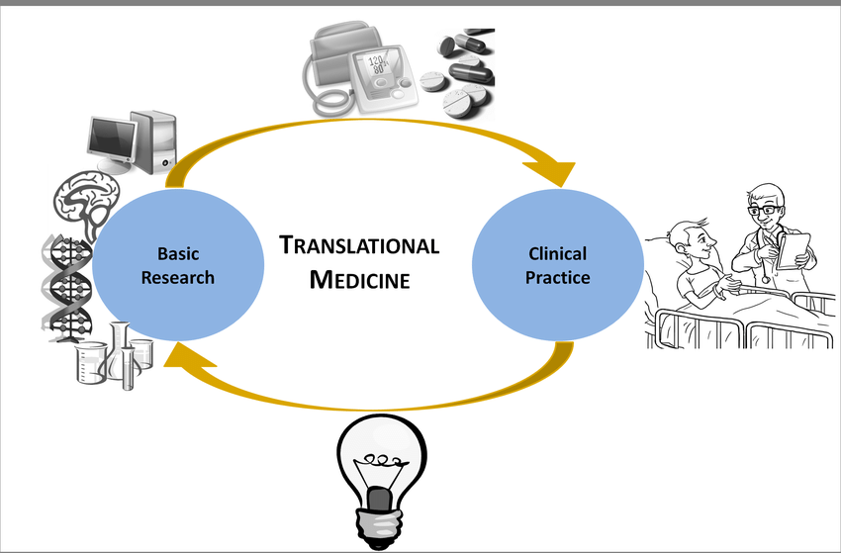
Biomedical Science
The primary responsibility of a biomedical scientist is to develop new treatments, vaccines and drugs for human illnesses and diseases.
The biomedical research needed to create new forms of treatment is generally conducted at a hospital, university or government laboratory.
May also be involved in clinical trials that monitor patients' reactions to different treatments, as well as make observations and conclusions about the results and the efficacy of those treatments.

Slide 4

Sac State has Bachelor of Science (B.S.) degree programs in Biomedical Sciences, Microbiology and Cell and Molecular Biology.
Many students volunteer in research labs as undergrads and many of the bench scientists have undergraduate science degrees.
Sac State also has a Masters of Science program in Molecular Cell Biology and a Masters of Arts program in Stem Cell Research.
Many Laboratory Research Scientist and Laboratory Manager positions are filled with Masters-level graduates.
The Principal Investigators generally hold a Doctor of Philosophy (PhD) or a Doctor of Medicine (M.D.) degree.
In some instances, biomedical scientists hold both a Ph.D. and a Doctor of Medicine (M.D.). This is especially true of persons who oversee clinical trials, since states require that medical scientists who draw blood from patients and administer drugs also be licensed physicians.

Slide 5
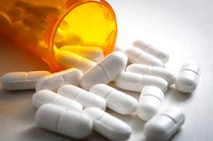
Drugs as Therapies
Categories of Drugs
Small-molecule drugs, usually derived from chemical synthesis
Biopharmaceuticals
Recombinant proteins
Monoclonal antibodies
Vaccines
Blood products
Gene and cell therapies

Slide 6
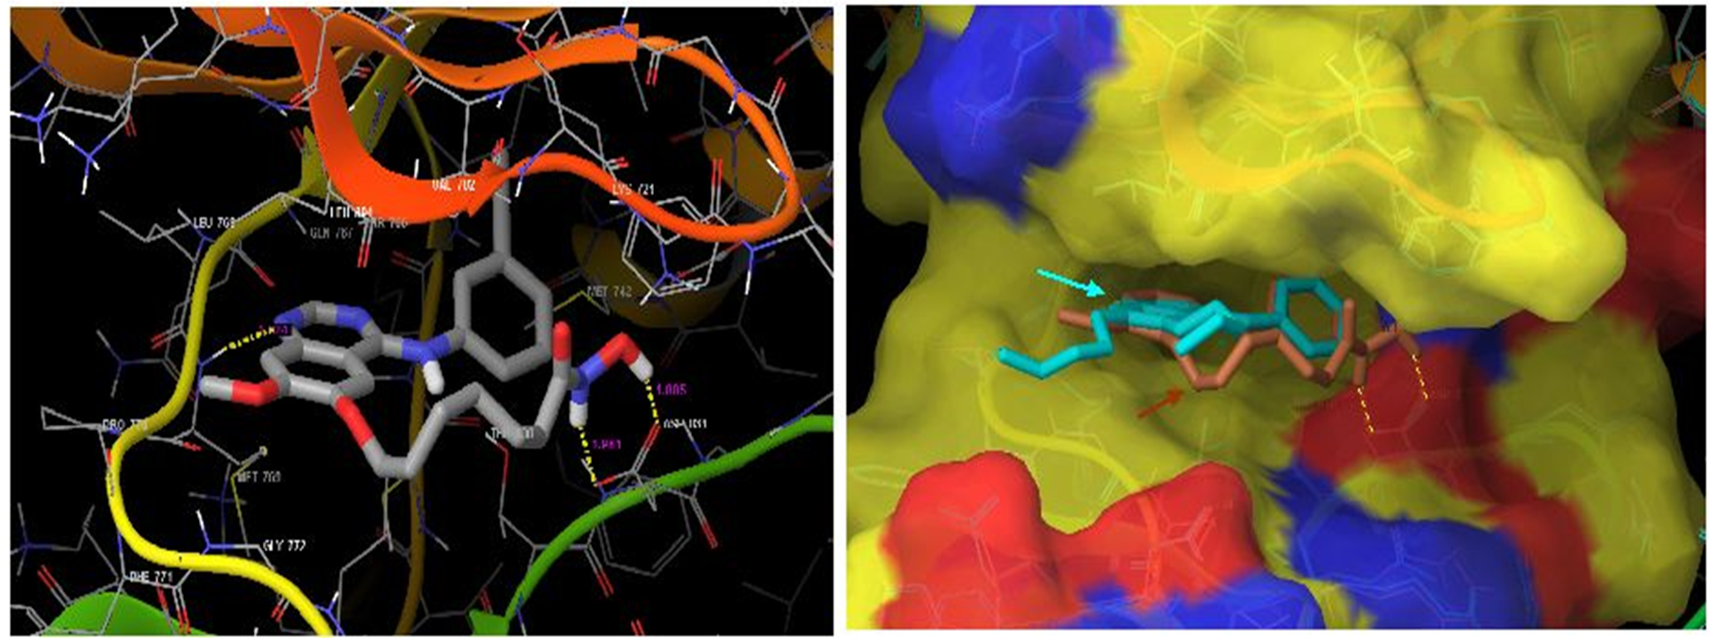
Percentage of all small molecule drugs aimed at specific targets
G-Protein-Linked Receptors 33%
Ion Channel Receptors 18%
Nuclear Receptors 16%
Intracellular Kinase Enzymes 03%
Other Molecules 30%
70% of all the drugs ever manufactured target receptors and second messenger cascade proteins
Engineered to fit in the active site, and either activate or inhibit the protein’s activity.

Slide 7
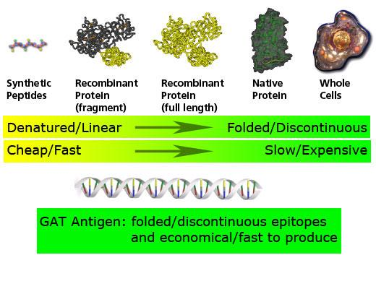
Biopharmaceuticals: Recombinant Protein Production
We can make significant quantities of any protein encoded by DNA, either natural or synthetic. It takes a lot of research to find something useful!

Slide 8
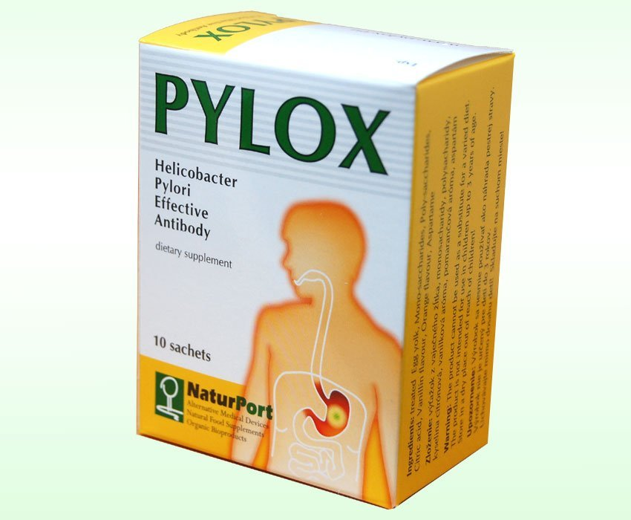
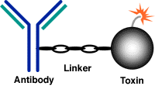
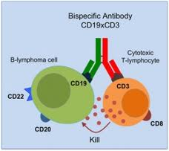
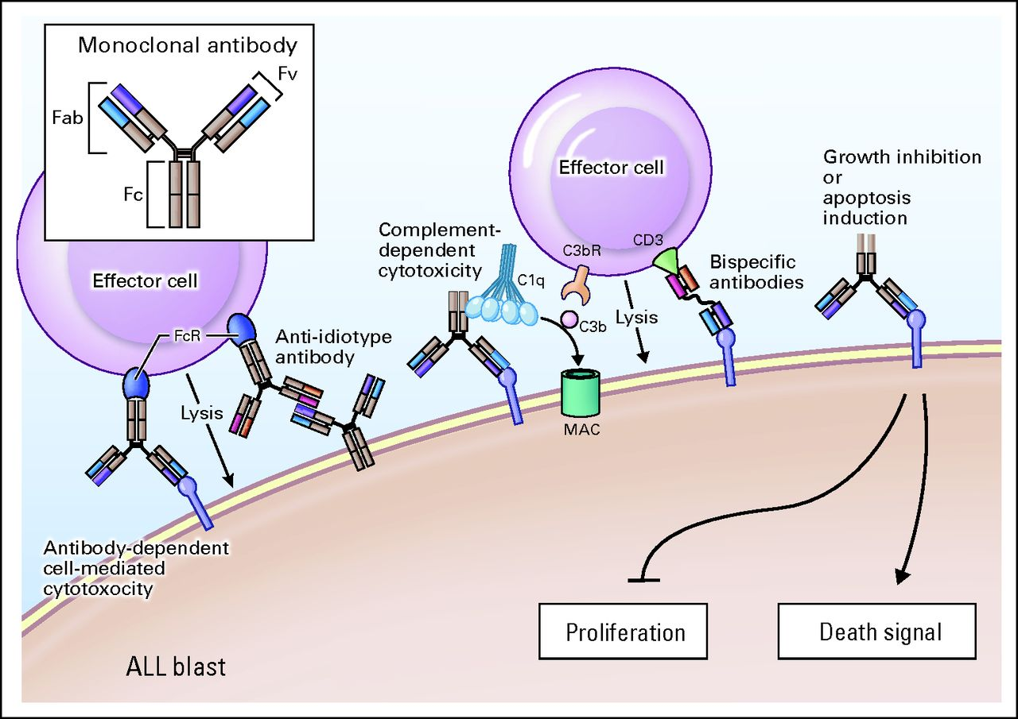
Antibody Therapies

Slide 9
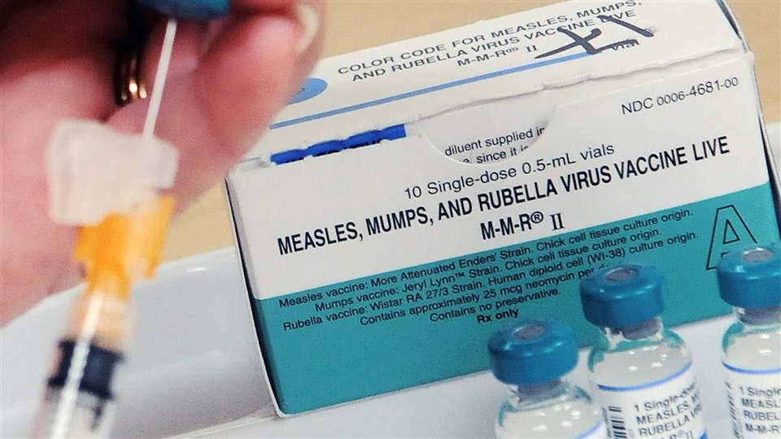
A vaccine is a biological preparation that provides active acquired immunity to a particular infectious disease.
A vaccine contains an agent that resembles a disease-causing virus or bacterium and is often made from weakened or killed forms of the microbe, its toxins, or one of its surface proteins.
1. Polio
2. Tetanus
3. Rubella
4. Measles
5. Whooping cough
6. Pneumococcal disease
7. Rotavirus
8. Mumps
9. Chickenpox
10. Diptheria
11. Haemophilus influenza type b
12. Hepatitis A
13. Hepatitis B
14. Influenza
14 diseases mostly eliminated by vaccine

Slide 10
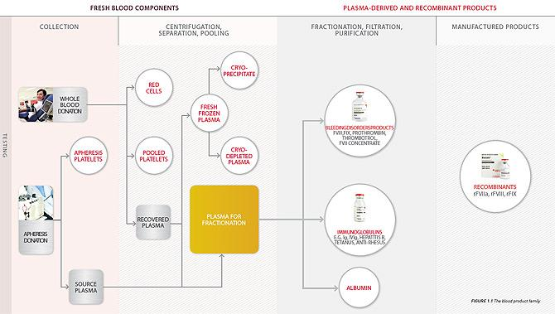
Blood Products include whole blood and several components, including red blood cells, white blood cells, platelets, plasma, etc.

Slide 11
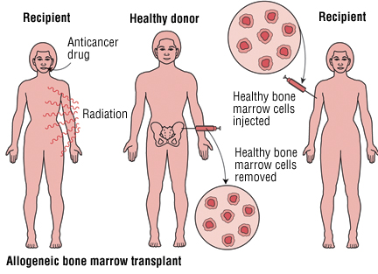
Cells as Therapy
Allogenic Bone Marrow Transplant
First successful transplant between identical twins – 1956
First successful transplant between non-identical – 1969
Both performed by American E. Donnall Thomas at the Fred Hutchison Cancer Center of the University of Washington

Slide 12
The Stem Cell Concept
Self-replenishing division of stem cells produces one new stem cell and one daughter that differentiates into a more adult cell type
In some organs: frequent replenishing divisions
gut, epidermis, bone marrow
example: billions of blood cells are destroyed by the spleen every hour
In others, they only divide in response to stress or the need to repair the organ
heart, prostate

Slide 13
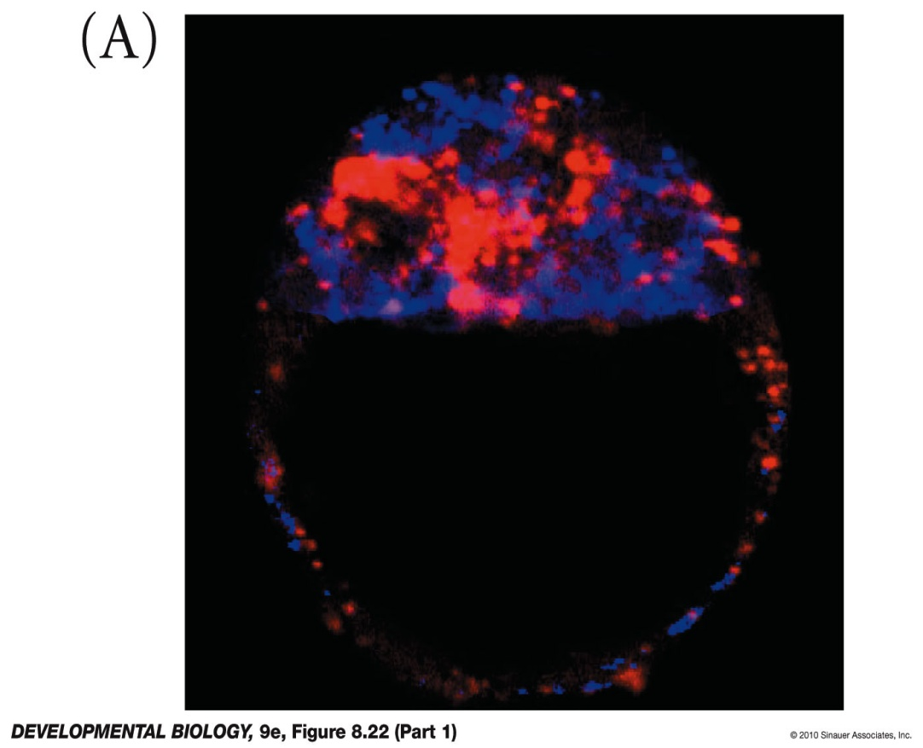
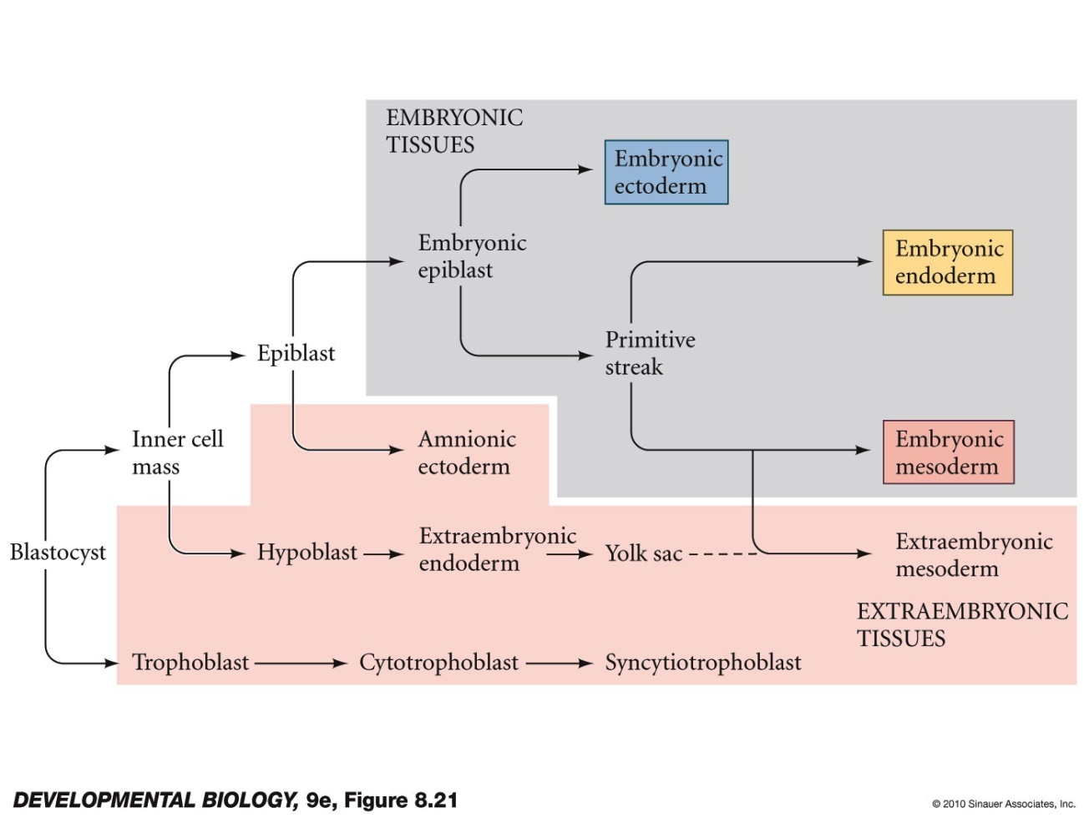
Types: Embryonic Stem Cells
“Pluripotent” means they can form any kind of cell in the organism
The inner cell mass of the preimplantation embryo or blastocyst

Slide 14
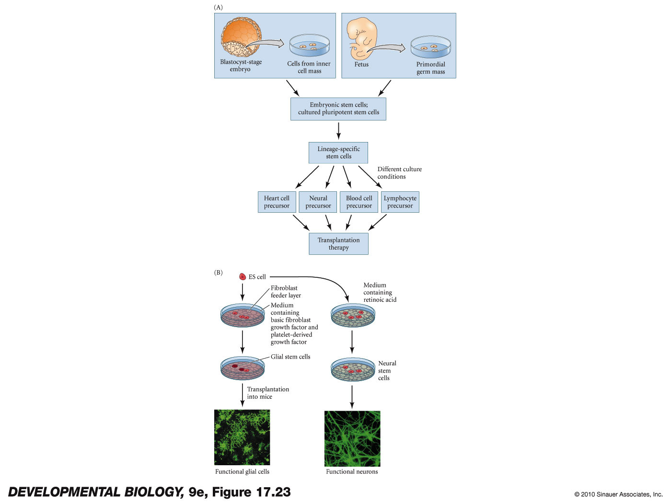
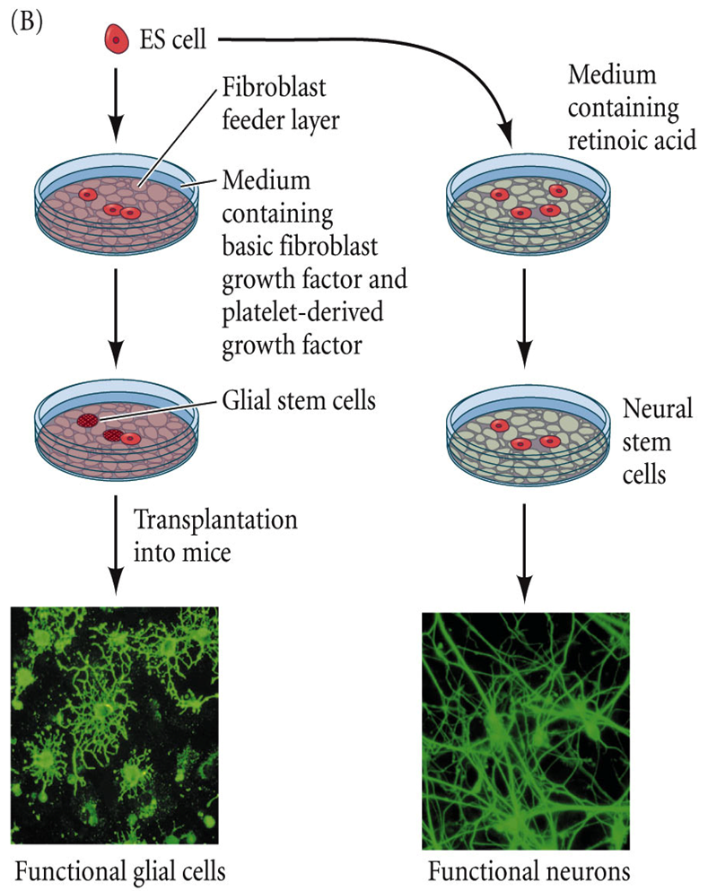
Embryonic stem cell therapeutics require that we can control the differentiation of the pluripotent cells into the kinds of cells we want to use. This is the hard part to figure out as there are over 200 adult cell types!
These cells require the destruction of an embryo and have been controversial.
There are two embryonic sources of ES cells
Notes:
DevBio9e-Fig-17-23-0.jpg

Slide 15
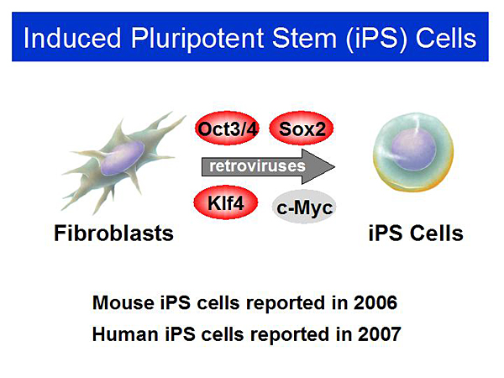
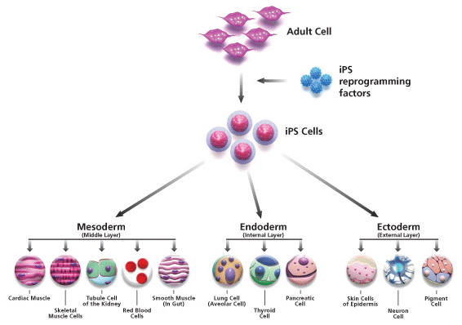
Induced Pluripotency
We have learned how to reprogram adult cells into pluripotent stem cells
Inserting 4 genes into adult cells does the trick
We can now use them like embryonic stem cells (mostly)

Slide 16
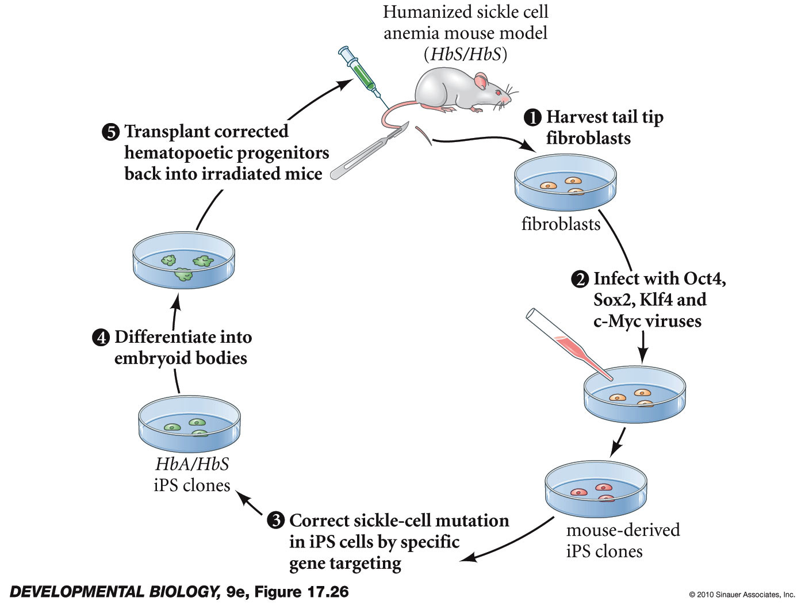
Protocol for curing a “human” disease in a mouse, using iPS cells plus recombinant genetics
Mouse with sickle-cell mutation
Collect adult cells, reprogram
Correct mutation in cell culture
Differentiate into RBC stem cells
Irradiate the mouse’s bone marrow
Inject repaired RBC stem cells
Notes:
DevBio9e-Fig-17-26-0.jpg

Slide 17
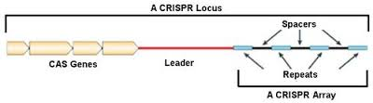
How do we repair the gene? Endogenous Genomic Editing with CRISPR
CRISPR is a Prokaryotic Acquired Immune System
Captured DNA from viruses and plasmids
Pieces incorporated into bacterial genome
They recognize original host DNA using captured DNA as template
CRISPR carries a DNA cutting tool that is used to cut up the invader
We have learned to control the cut and put new DNA into the break

Slide 18
Types: Adult Stem Cells
Already committed stem cells with fewer potential fates
hematopietic stem cells -- hair stem cells
mesenchymal stem cells -- melanocyte stem cells
epidermal stem cells -- muscle stem cells
neural stem cells -- tooth stem cells
gut stem cells -- germline stem cells
mammary stem cells
Hard to extract and culture
HSC are less than 1 in 15,000 bone marrow cells
Transplants often work very well, however
Mammary, neural, muscle, others all being worked on

Slide 19
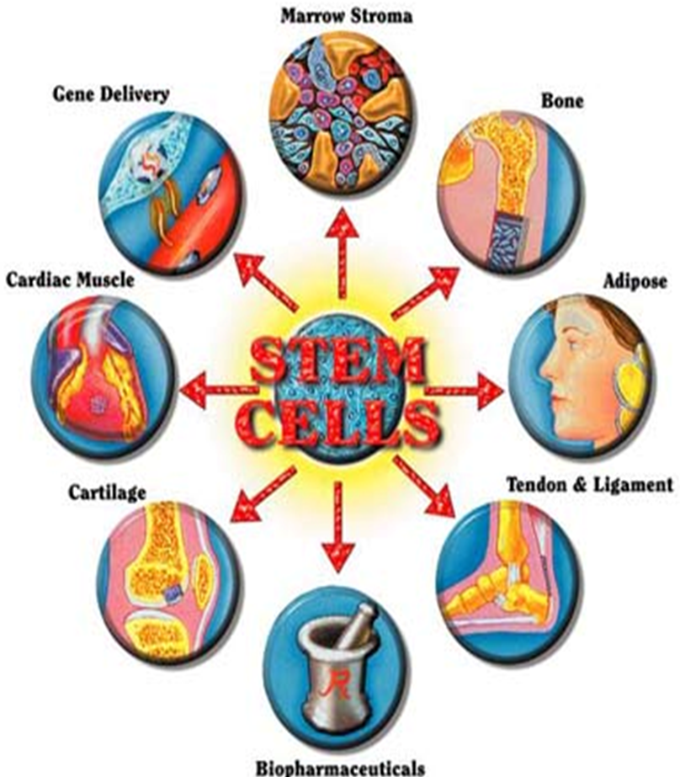
Types: Mesenchymal Stem Cells
Surprising degree of differentiation options
Muscle, fat, bone, cartilage
PDGF, TGF-B, FGF combinations determine fate
Found in lots of places in embryo and adult
Umbilical cord blood, baby teeth
Bone marrow, fat, muscle, thymus, dental pulp
organogenesis in many tissues requires developing special sites for stem cells to live
Microenvironments wherein the cells that stay don’t differentiate but those that leave do

Slide 20
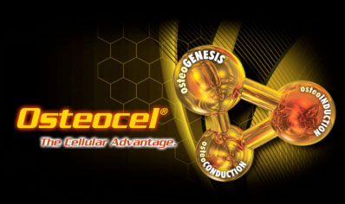
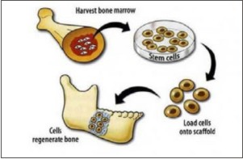
Bone healing started with a collagen matrix full of Mesenchymal Stem Cells
Now there are products that allow us to put mesenchymal stem cells directly into the broken bone.
This technology was developed first for animal athletes, dogs and horses

Slide 21
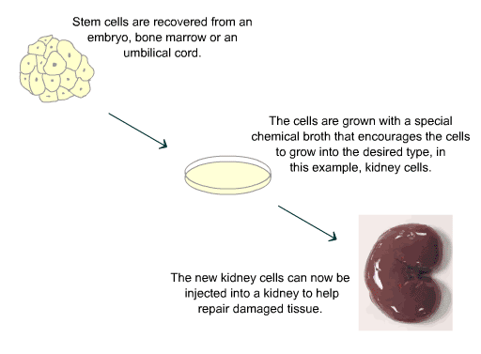
Stem Cells and Organ Therapy

Slide 22
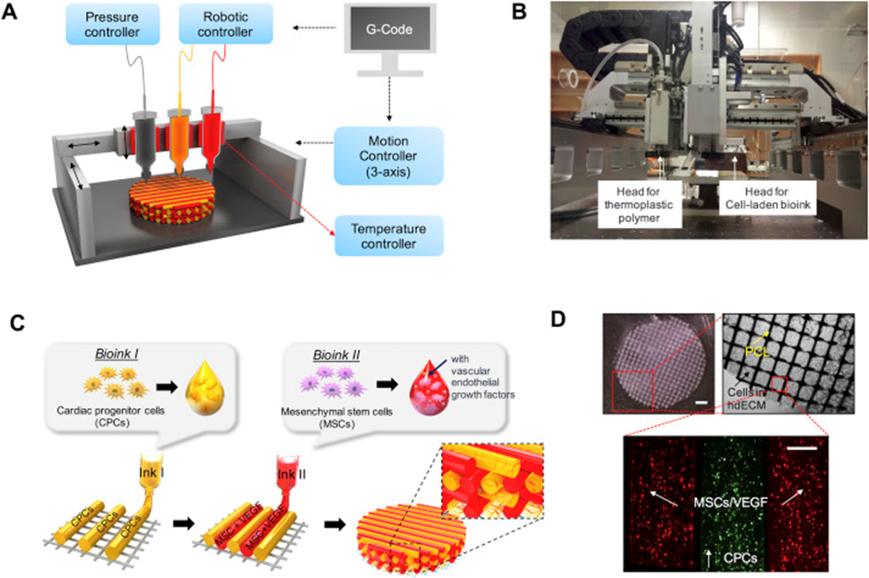
3-D Printing and Organ Replacement Therapy
Option 1: Use a donor organ, take all of the cells out of it, and put healthy cells back in.
Option 2: Use human proteins and CAD to print an organ’s structure and put healthy cells into it.

Slide 23
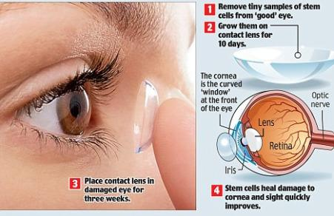
Stem Cells and Corneal Therapy

Slide 24
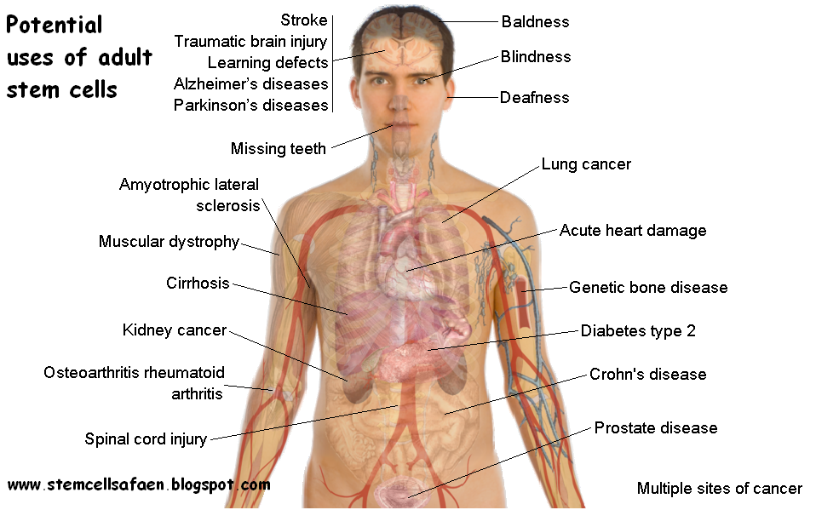
There are so many potential diseases where replacing cells might work that the only limitations are knowledge and imagination

Slide 25
Biotechnology – the use of organisms to make useful products (and for the advancement of knowledge)
Includes methods that utilize or modify organisms to satisfy human needs:
Selective breeding – food and others
Cellular fermentation products – food and drinks
Genetic engineering – medicine and food

Slide 26
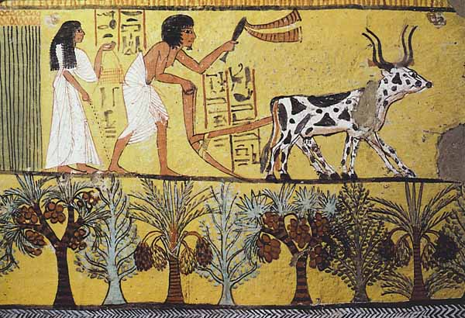
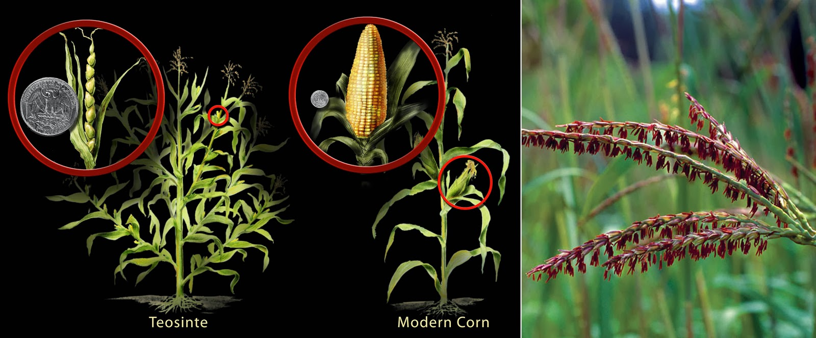
Using Organisms for our Needs
It All Started With Agriculture
Domestication of plants and animals is the earliest biotech enterprise
>12,000 years ago
Provided controllable means to get food
Allowed humans to settle in place
Early farmers selected and bred crops with the best yield
Today’s corn was bred from Teosinte grass

Slide 27
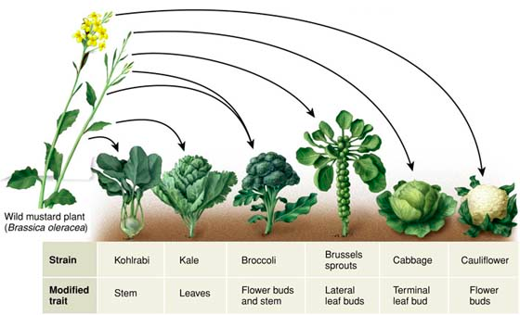
Selective Breeding (= Artificial Selection) enabled the selection of animals/plants with different desirable traits
Derivatives of the wild mustard plant
‹#›

Slide 28
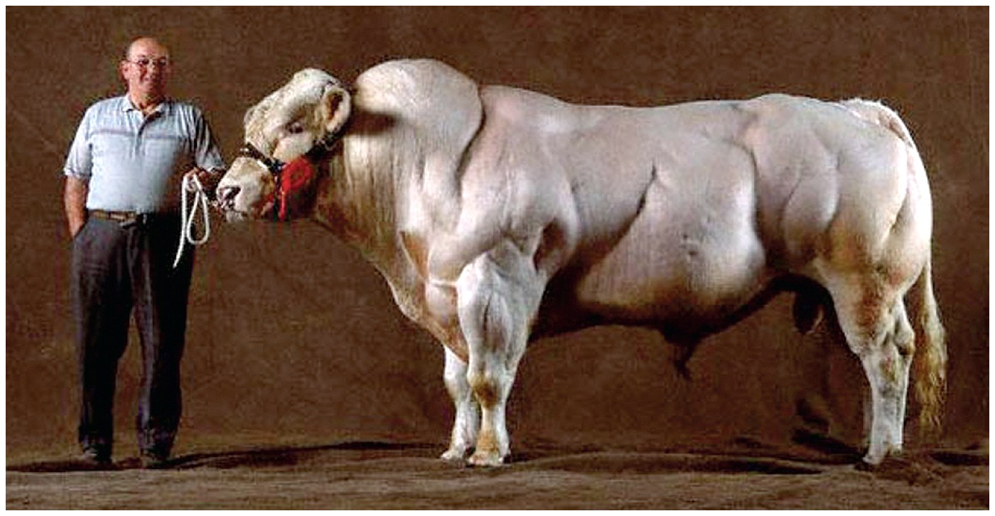
Breeding is molecular transformation the old way
We discovered that a mutation in a signal that reduces muscle cell division was bred in. Now we can engineer it.

Slide 29
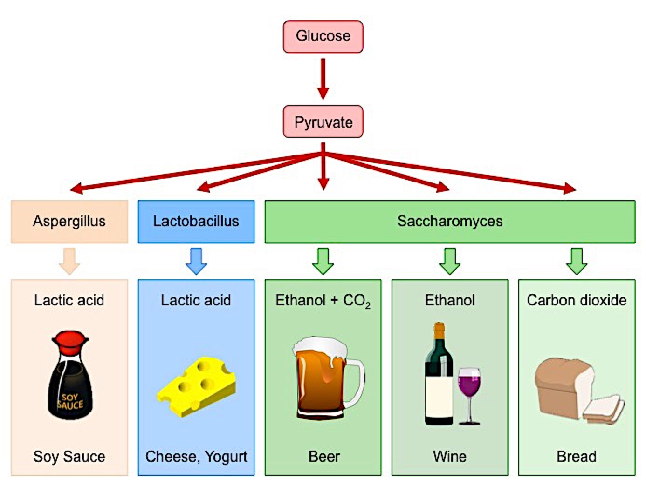
Fermentation is Big Business
Use of metabolic process (fermentation) to make products useful to humans
acids, gases and alcohol are the (waste) products of fermentation
humans use these metabolic wastes to make products
Glycolysis
No Oxygen -> Fermentation

Slide 30
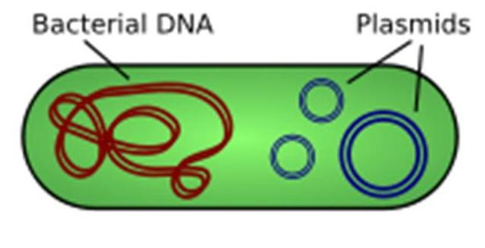
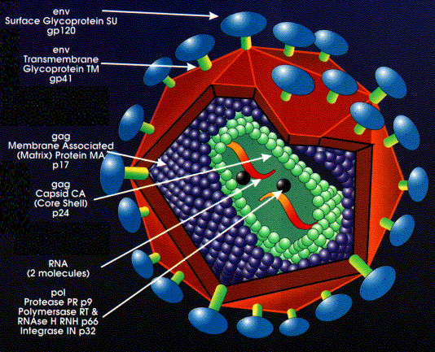
Genetic Engineering and Genetically Modified Organisms
Direct manipulation of an organism’s DNA to produce a desired phenotype
Moving genetic material from one organism to another allows transgenic organisms to make products (proteins) that the original organism could not make
For ease of use, we have co-opted the genomes of simple organisms
Viruses

Slide 31
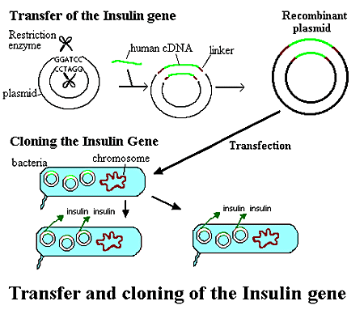
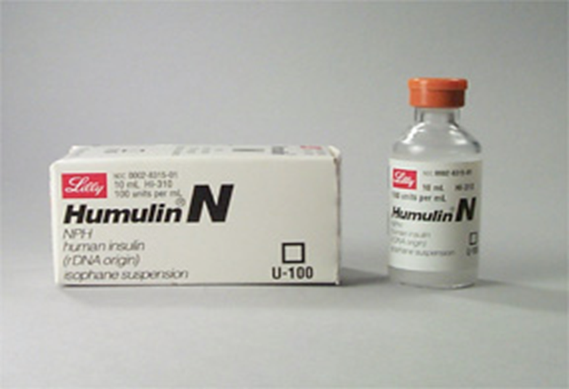
Genentech’s cloning of insulin in bacteria was the first molecular product to market
Humulin – human insulin from E. coli grown in a lab (Genentech 1970’s)
Same process is used to make many other protein products now:
Human Growth Hormones
Antibiotics

Slide 32
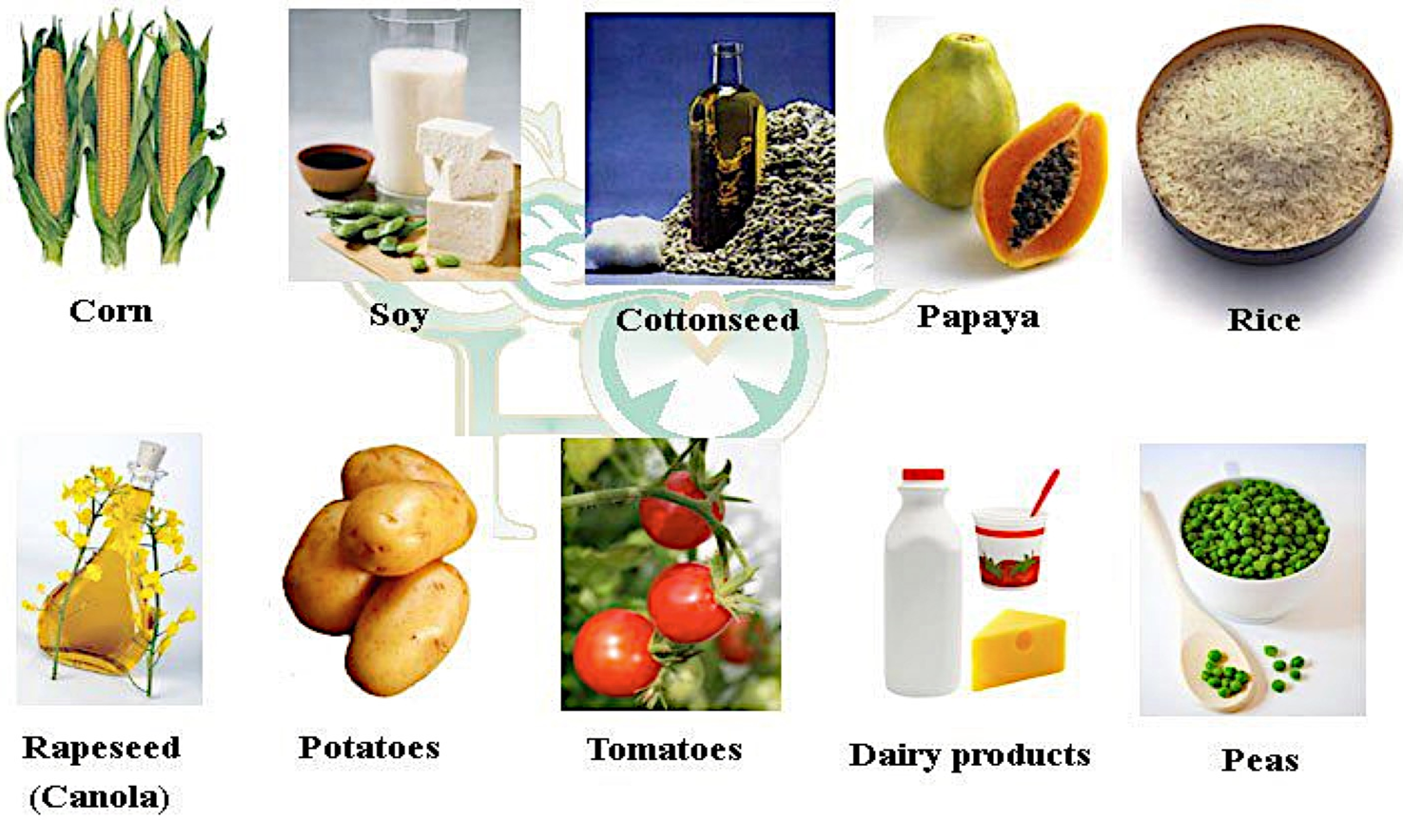
Genetically Modified Organisms (GMO’s)
Genetically Modified (GM) crops – transgenic plants used in Agriculture
Aim is to introduce traits that did not exist in the original plant
Resistance to pests, disease and harsh environments
Reduction of spoilage
Better flavor/nutrition value
Top 10 GMO’s

Slide 33
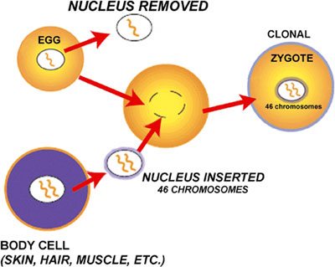
Organismal Cloning is creating exact genetic matches in whole, intact organisms through somatic cell nuclear transfer into an egg.
Cloning in Human Health and Disease

Slide 34
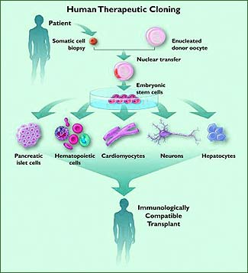
Therapeutic Cloning is using this technology to create cellular therapies that match the patient’s DNA exactly

Slide 35
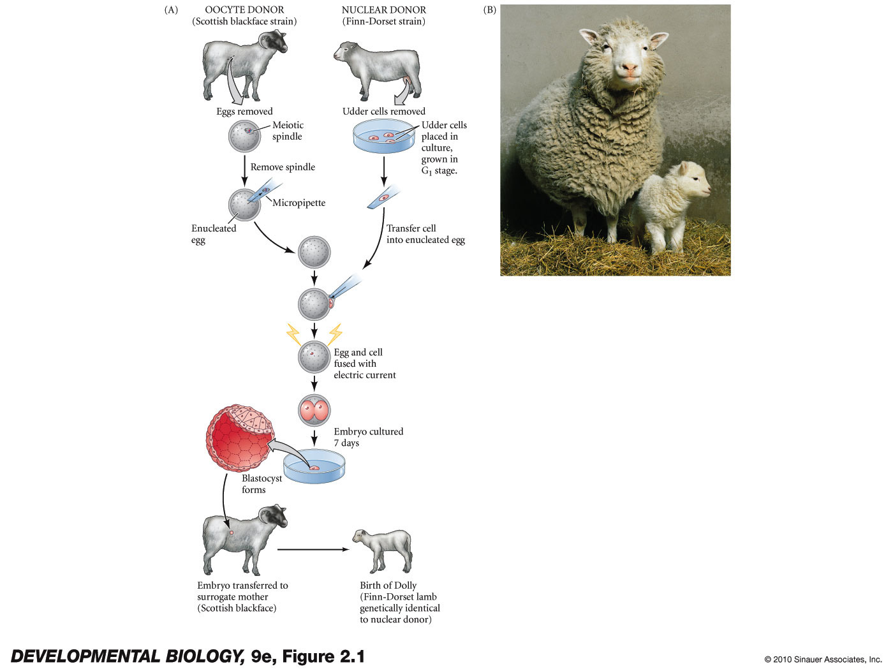
Reproductive Cloning is using the technology to transfer the zygote into the womb of a host.
sheep
cats
horses
mules
cows
oxen
deer
g. pigs
rabbits
rats
mice
dogs
fish
humans?
The original: Dolly
Notes:
DevBio9e-Fig-02-01-0.jpg

Slide 36
The Moral Conundrum
There is tremendous knowledge and power in the hands of scientists today
Changing genes and genetics are relatively easy processes
People being people, peer and government oversight is absolutely critical
There is big money behind curing disease and eliminating gene defects
Financial gain can, unfortunately, over-rule moral considerations
We must always be vigilant – with great power, comes great responsibility!

